Slide 1
Where to Restaurant?
How can we determine the best zip code in New York to open a new restaurant?

Slide 2
Why is this important?
As noted by a CNBC article, over 60% of new restaurants fail within the first year and “Often, the No. 1 reason is simply location.”
Choosing a good location is one of the most important things a restaurateur will do to determine whether that restaurant succeeds or fails. This tool can help to quickly narrow that search so restaurateurs can be confident they are choosing the best location.

Slide 3
Where does the data come from
New York health inspection data tells us what kinds of restaurants already exist in NYC and where they are located.
This is useful for choosing a location that is not already oversaturated with competition in your market.
US Census data tells us the characteristics of the people living in each zip code such as income, population, and age
This helps to identify areas with large numbers of your target customers
NYC zip code coordinates allow us to map the data so you can quickly see which areas have high potential value and which areas are not worth investigating.

Slide 4
How is the data cleaned?
All missing data is removed, leaving 179 unique zip codes.
Five important values are calculated for each zip code
Proportion of each cuisine type
Total population
Median income
Restaurants per capita
Percentage of each age group (0-14, 15-29, 30-54, 55+)
All these values are rescaled so that they range from 0-1
Cuisine proportion and restaurants per capita are inverted because for those a lower value is preferred

Slide 5
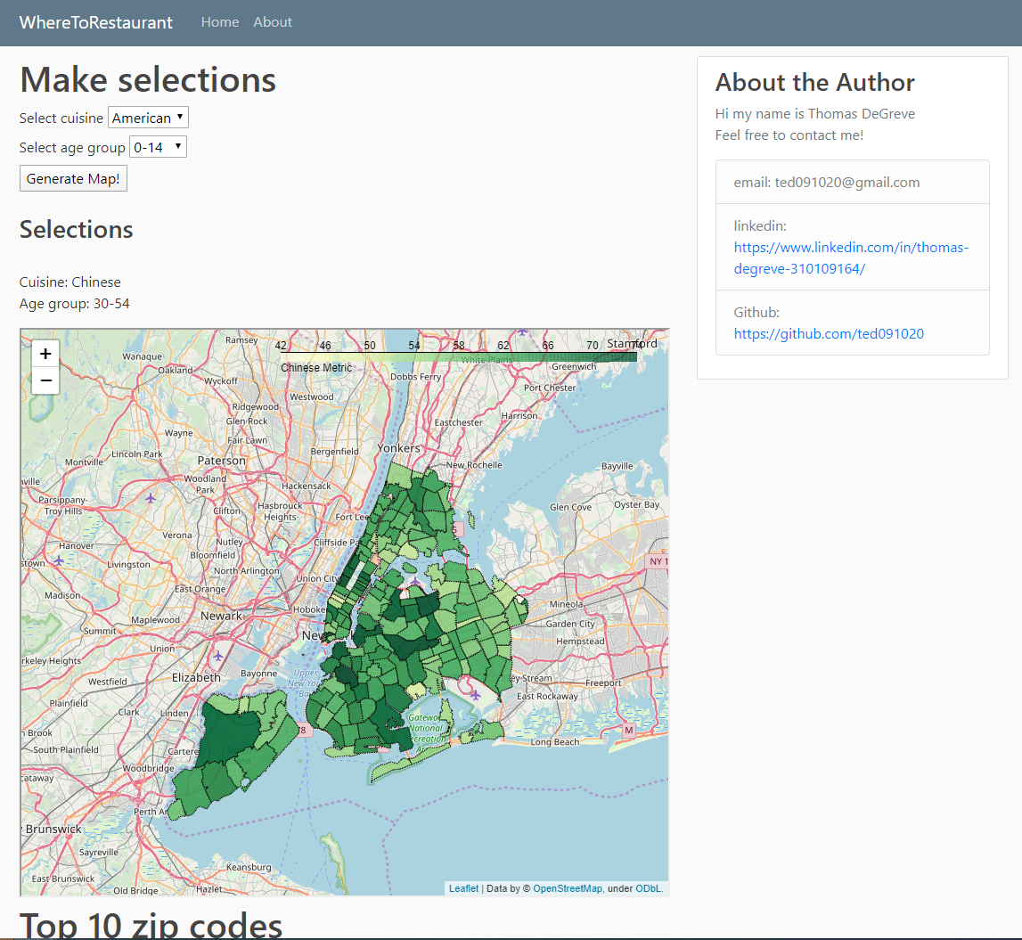
How is the tool used?
When the user selects a cuisine type and target age range, the five important values are summed and multiplied by 20 to give a final metric that ranges from 0-100.
A choropleth map is then generated using folium in which the brightness of each zip code corresponds to the value of the final metric
Additionally the user receives a list of the top 10 zip codes with all of the relevant data for each zip code.

